Slide 1

DEPARTMENT OF CSE (ARTIFICIAL INTELLIGENCE AND MACHINE LEARNING) ACADEMIC YEAR 2025 - 2026 SEMESTER III ARTIFICIAL INTELLIGENCE LABORATORY MINI PROJECT REVIEW AI-DRIVEN TIC TAC TOE USING PROPOSITIONAL LOGIC AND KNOWLEDGE-BASED SYSTEM
REGISTER NUMBER | 2117240030011
NAME | ARSHEEN FATHIMA A
YEAR | II
SECTION | A
FACULTY IN-CHARGE | Mrs. M. Divya

Slide 2
PROBLEM STATEMENT
Artificial Intelligence (AI) enables systems to mimic human reasoning and make intelligent decisions through logic-based analysis.
This project focuses on designing a Knowledge-Based Tic Tac Toe Game using Python and Tkinter, where the AI applies a set of predefined logical rules to play against a human user.
The system uses propositional logic and rule-based inference to identify winning opportunities, block the opponent’s moves, and select the best available position.
Unlike probabilistic or learning-based models, the AI here relies purely on deterministic reasoning for decision-making.
The project also integrates a Graphical User Interface (GUI) for user-friendly interaction, providing visual feedback for each move.
Overall, the system demonstrates how knowledge representation and logical inference can be effectively applied to build an intelligent, interactive game-playing agent.

Slide 3
THEORETICAL BACKGROUND
Tic Tac Toe serves as an ideal platform to demonstrate Artificial Intelligence (AI) and logical reasoning in decision-making.
The objective is to develop an AI that can analyze the board and choose the best possible move intelligently.
A Knowledge-Based System (KBS) forms the core of this project, using predefined logical rules to represent expert strategies.
The Inference Engine applies these rules to make moves based on the game situation
For example: “If two X’s are in a line and the third cell is empty, place X to win.”
The AI employs propositional logic for reasoning, enabling it to detect winning opportunities or block opponent moves.
Unlike machine learning systems, this approach uses deterministic, rule-based reasoning, making decisions transparent and explainable.
A Tkinter-based GUI provides a colorful, user-friendly interface for real-time interaction between the human player and the AI agent.

Slide 4
THEORETICAL BACKGROUND
Algorithm
1. Initialize the Game Board
Create a 3×3 board represented by a list or matrix.
Assign "X" for AI moves, "O" for player moves, and " " for empty spaces.
2. Define Knowledge Base Store logical rules such as:
If AI can win in one move → make that move.
If the opponent can win in one move → block that move.
Otherwise, choose the best available cell (corner, center, or side).
3. Check for Winner After every move, evaluate all winning combinations:
Rows: (1,2,3), (4,5,6), (7,8,9)
Columns: (1,4,7), (2,5,8), (3,6,9)
Diagonals: (1,5,9), (3,5,7)
If all positions in any combination are the same symbol, declare the winner.

Slide 5
THEORETICAL BACKGROUND
4. AI Move Decision (Knowledge-Based Reasoning) Apply rule-based inference:
Test each possible move for a winning state.
If no win, test each move for blocking an opponent win.
If neither applies, select the next best logical move.
5. Human Interaction (GUI Input)
Use Tkinter buttons to capture player input dynamically.
Update board visuals with colors for "X" and "O".
6. Display Result After each move:
Update GUI to show the current state.
If a win or draw occurs, display a colored message (“AI Wins”, “You Win”, “Draw”).
7. Restart or Exit
Provide options to reset the board and play again.

Slide 6
IMPLEMENTATION AND CODE
Link to code in Git-hub Repository
List | Git-hub Repository Links
Implementation of Code Link | https://github.com/ARSHEEN29/AI-DRIVEN-TIC-TAC-TOE-/tree/main

Slide 7
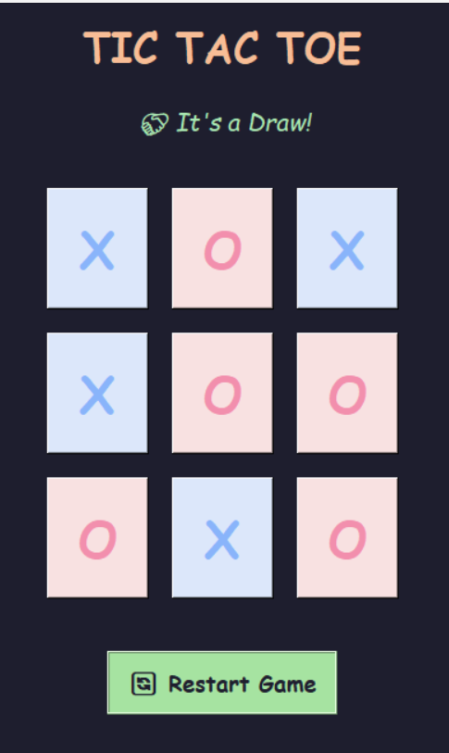
OUTPUT AND RESULTS
The output shows the final state of the Knowledge-Based Tic Tac Toe Game developed using Python’s Tkinter.
Here, both the AI (X) and player (O) have made their moves based on logical rules, resulting in a draw.
The AI applies rule-based reasoning to analyze the board, block opponent moves, and attempt to win strategically.
The colorful interface, result message (“It’s a Draw!”), and Restart Game button enhance interactivity and user experience.

Slide 8
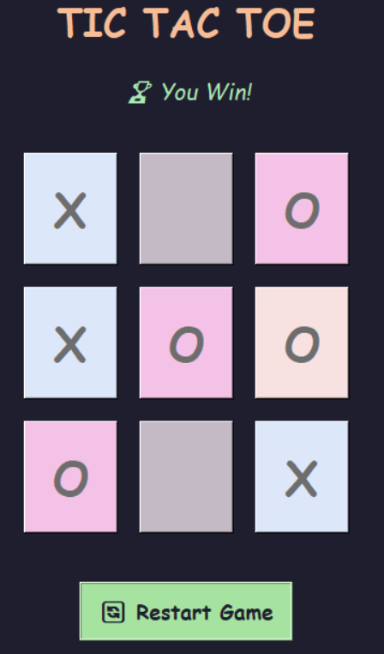
OUTPUT AND RESULTS
This output represents the winning screen of the Knowledge-Based Tic Tac Toe Game.
Here, the player (O) has successfully aligned three symbols diagonally, resulting in victory.
The message “You Win!” confirms the outcome with a cheerful interface and a trophy icon.
The Restart Game button allows the user to replay, promoting interactivity and fun gameplay.

Slide 9
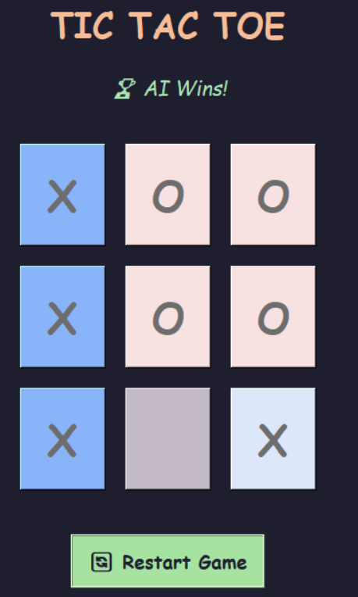
OUTPUT AND RESULTS
This output represents the AI victory screen in the Knowledge-Based Tic Tac Toe Game.
Here, the AI (X) wins by forming a vertical line of three X’s, showcasing intelligent decision-making.
The message “AI Wins!” appears with a trophy icon, indicating the computer’s success.
The Restart Game button allows players to start a new round and challenge the AI again.

Slide 10
OUTPUT AND RESULTS
Result
The output represents the AI victory screen in the Knowledge-Based Tic Tac Toe Game, where the artificial intelligence successfully outsmarts the player.
In this scenario, the AI (X) strategically forms a vertical line of three X’s, demonstrating its logical reasoning and intelligent move prediction.
The victory message “AI Wins!” appears at the top of the interface with a trophy icon, symbolizing the AI’s achievement in the game.
This result validates the effectiveness of the AI algorithm, which evaluates all possible moves to ensure an optimal strategy.
The visually appealing interface uses color-coded grids to clearly highlight the winning pattern. Additionally, the Restart Game button provides users with an option to play again, encouraging continuous interaction and testing of different strategies.
Overall, this output confirms the AI’s capability to make data-driven decisions and achieve consistent winning outcomes.

Slide 11
OUTPUT AND RESULTS
Future Enhancements
Multiplayer Mode: Introduce an online multiplayer feature allowing users to play Tic Tac Toe with friends or other players in real time.
Improved AI Intelligence: Enhance the AI using Minimax algorithm with depth optimization or reinforcement learning to make more advanced strategic moves.
Difficulty Levels: Add multiple AI difficulty settings (Easy, Medium, Hard) to make the game suitable for all users.
Voice Interaction: Integrate voice-based commands to allow users to make moves or restart the game through speech recognition.
Enhanced User Interface: Add sound effects, animations, and theme customization to improve user engagement and visual appeal.

Slide 12
REFERENCES
References
Russell, S., & Norvig, P. (2020). Artificial Intelligence: A Modern Approach (4th Edition). Pearson Education.
GeeksforGeeks – Tic Tac Toe AI using Minimax Algorithm in Python. Available at: https://www.geeksforgeeks.org/tic-tac-toe-ai-using-minimax-algorithm-in-python/
W3Schools – JavaScript Game Tutorial: Tic Tac Toe. Available at: https://www.w3schools.com/
Towards Data Science – Building a Tic Tac Toe AI using Python and Minimax. Available at: https://towardsdatascience.com/
Python Official Documentation – Tkinter GUI Programming. Available at: https://docs.python.org/3/library/tkinter.html

